Slide 1

System on Chip for Measurement of Physiological Characteristics
CalState Long beach

Slide 2
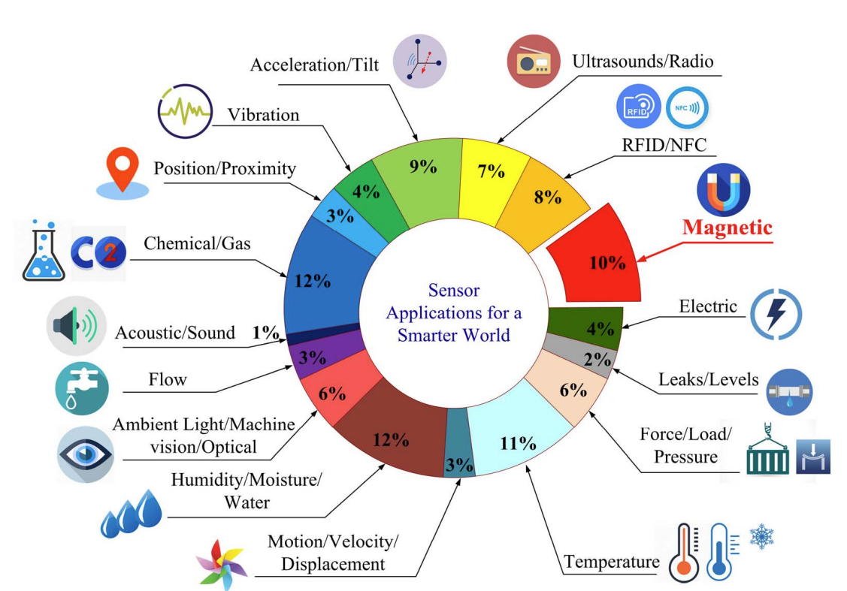

Why are we here:
Commercial chip design software needs a lot of external resources, NDA’s, and funding. Making chip fabrication on small scales is hard to achieve.
We believe sensors are building blocks of various applications!
Who we are?
Team USA 4: Ava Hedayatipour, PhD, Assistant Professor, CSULB
Ricardo Bazutro, MS, Student, CSULB
Channel Lee, MS, Student, CSULB
My class of Fall 2022 EE532
Current expertise: -I have implemented and published on secure temperature and impedance sensors. during my Ph.D. (Graduated in August 2020).
Picture from: Xuyang et. al, Overview of Spintronic Sensors With Internet of Things for Smart Living
Notes:
Started my faculty position in August 2020, and have been implemented a secure temperature and impedance sensor.

Slide 3
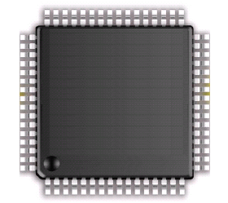
What are we designing and why?
The goal of this research is to take advantage of today's technology in the implementation of robust, inclusive sensor systems that are compatible with of wearable/portable devices.
The System on Chip (SoC), detects temperature, impedance, and changes in light absorption on a low-power, low-area integrated chip that includes power management, data transmitting, and initial processing blocks.
The processing block aims to remove inaccuracies due to skin pigmentation, environment temperature, and movement using active feedback.
Impedance
Power Management
Temperature
Data Acquisition
Light Absorption
Control and
Pre-Processing
Notes:
A photoplethysmogram (PPG) is an optically obtained plethysmogram that can be used to detect blood volume changes in the microvascular bed of tissue.^{[1][2]} A PPG is often obtained by using a pulse oximeter which illuminates the skin and measures changes in light absorption.^{[3]}

Slide 4
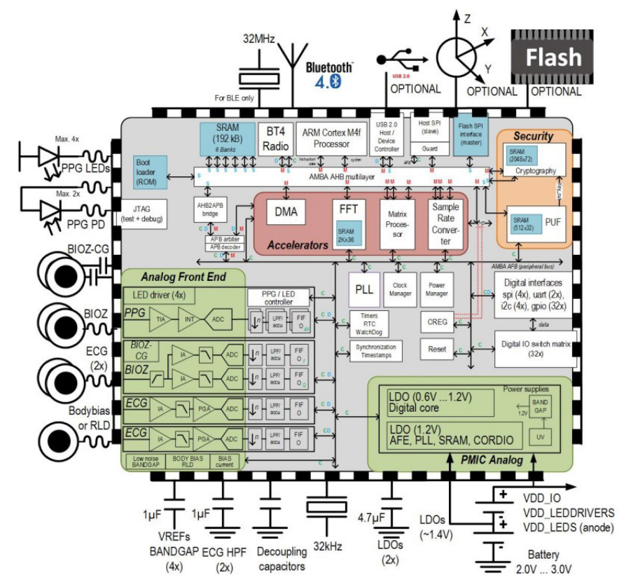
What is our design progress?
Block contribution to Open Source IP:
Temperature sensor, Dynamic feedback PPG, Impedance sensor
 |  | Design | Simulation | Layout | Post layout
PPG | PGA | Yes | Yes | Ongoing | No
 | IA
 | Control
Temperature sensor |  | Yes | Ongoing | No | No
Impedance sensor |  | Yes | Ongoing | No | No
Power (LDO, BGR) Common blocks available
ADC Common blocks available
Picture from: Song et. al, A 769 uW Battery-Powered Single-Chip SoC with BLE for Multi-modal Vital Sign Monitoring Health Patches

Slide 5
Initial results
Control unit (multiplexer and encoder) to control the gain
Initialization pulse with different intensities
LED driver
Transient output from the PPG (v)
Normal pulsating
PGA
Time (ms)
By testing discrete devices, when pulsing LED with different light intensities, based on the background the change in reflected light is different.

Slide 6
Thank you!

